Slide 1
Hacking the Phone System
Development solutions which change how people communicate
Tom Morgan
@tomorgan

Slide 2
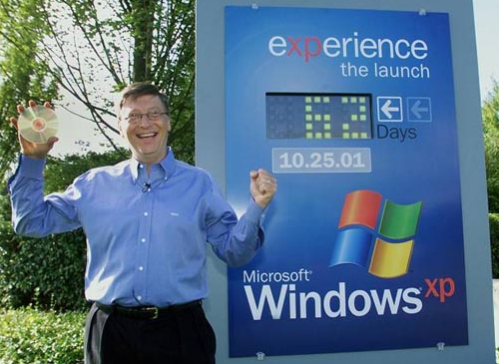
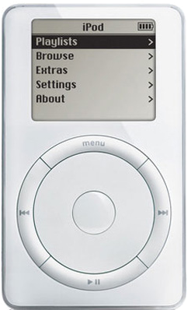
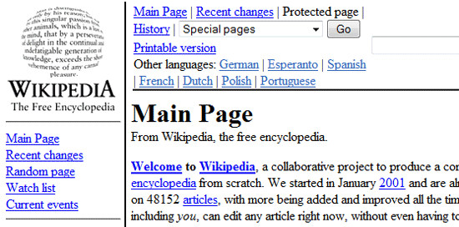
2001

Slide 3
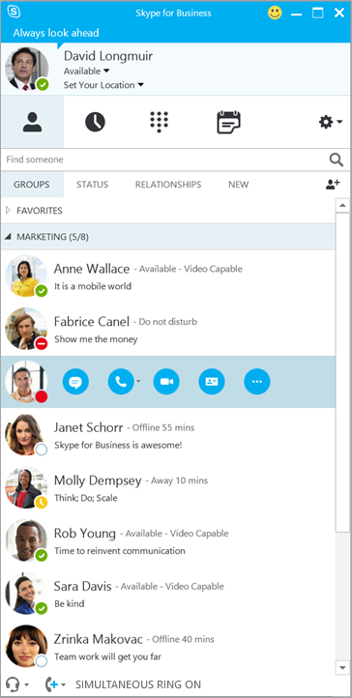
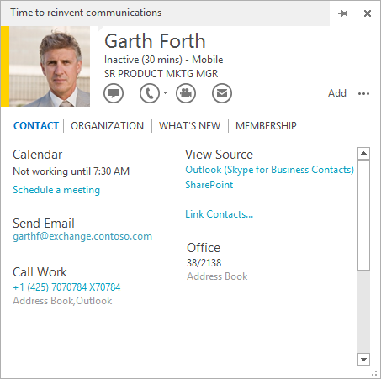
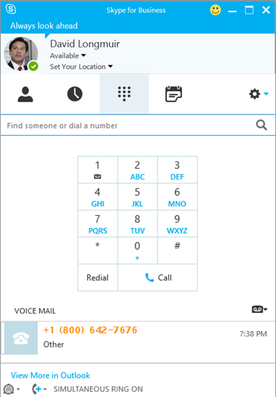
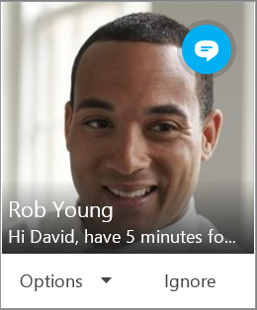

Slide 4
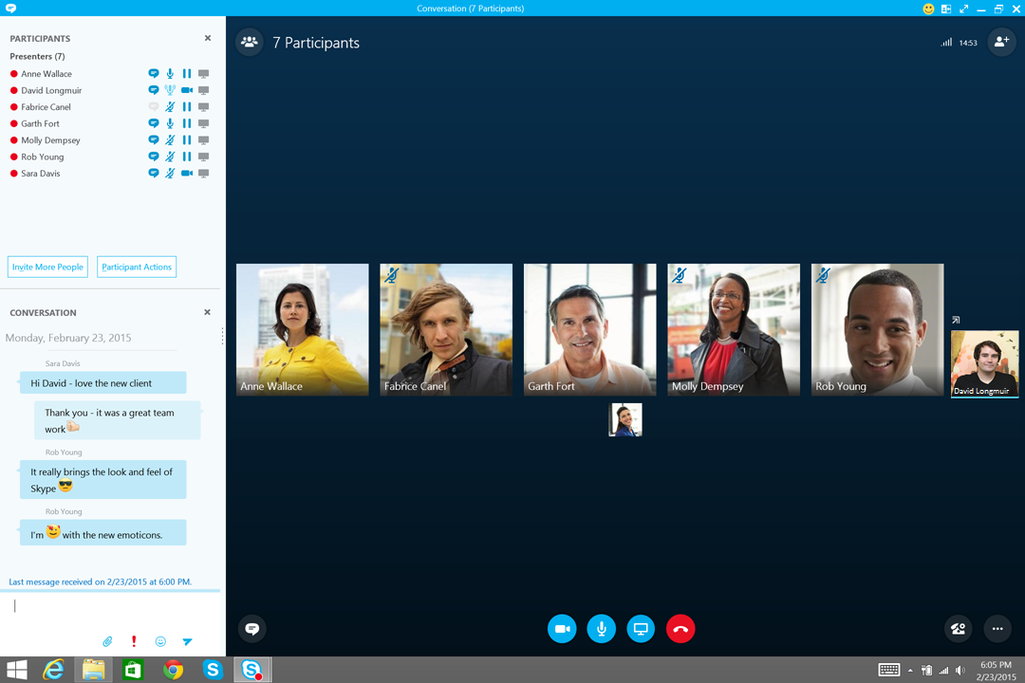

Slide 6
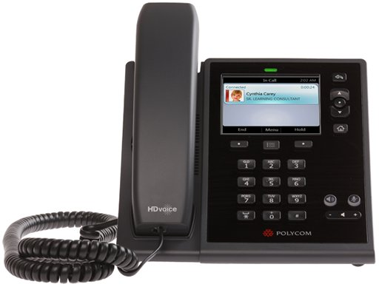
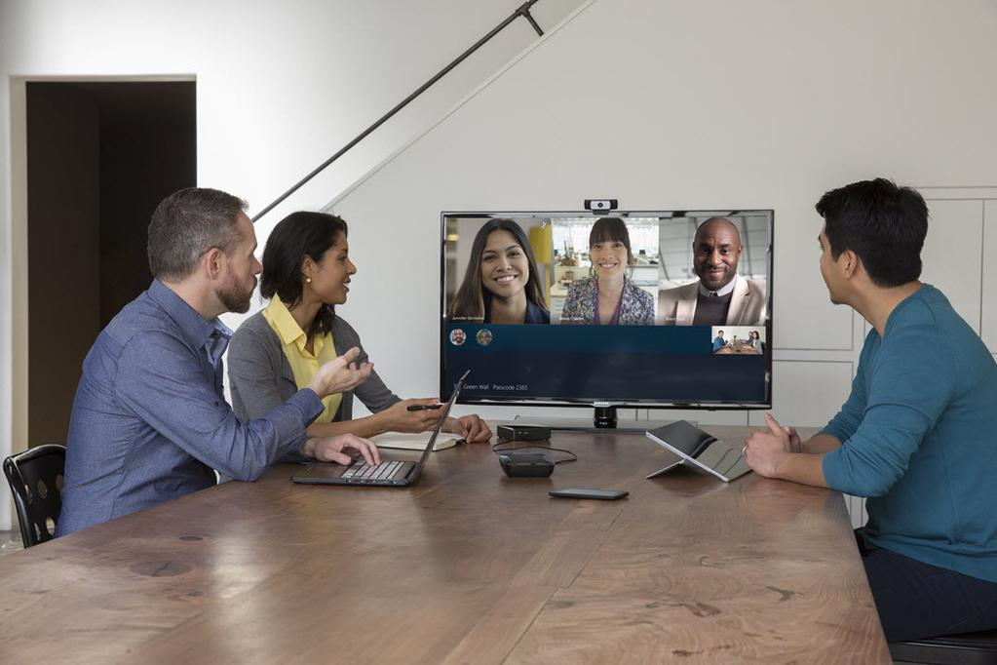
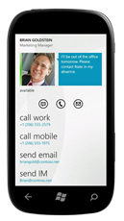
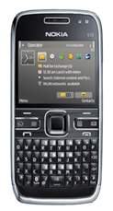
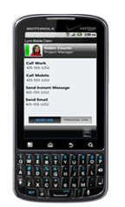
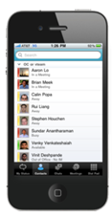

Slide 7
Development Tools
Silverlight / WPF Controls
Conversation Window Extensions
Microsoft Lync Client SDK
UI Suppression Mode
Lync Server SDK
Unified Communications Web API (UCWA)
Unified Communications Managed API (UCMA)
Skype for Web SDK – April/May 2015

Slide 8
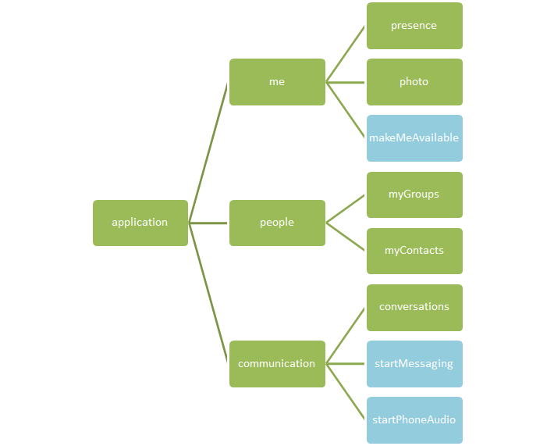
UCWA Hypermedia

Slide 9
UCMA Application

Slide 10
Find out more
Search “MSDN Lync development”
My blog: blog.thoughtstuff.co.uk
Twitter: @tomorgan
Slides / Code: thoughtstuff.co.uk/nordev

